Slide 1
de Brujin graph

Slide 2
What is a de Brujin graph
A de Brujin graph is a data structure that can efficiently represent a read sequence in terms of k-mers.

Slide 3
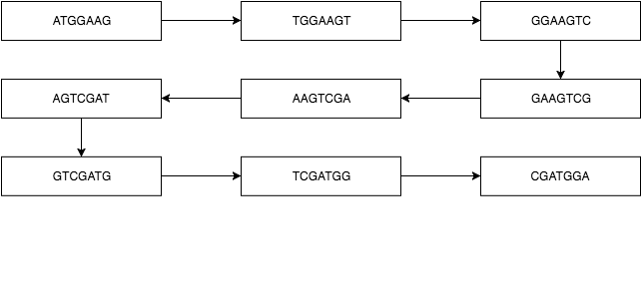
Example
Lets take the following sequence into consideration: ATGGAAGTCGATGGA.

Slide 4
Metagenome Assembly
With MetaValvet

Slide 5
The problem
Assemble metagenomes from a mixed sequence of reads of multiple species.
The methods of metagenome assembly are very limited, and single genome assemblers are often used for metagenome assembly. However, single-genome assemblers are not designed to assemble multiple genomes.

Slide 6
MetaValvet
Implements functions from a single-genome assembly algorithm ‘Valvet’ and adds on to its assembly pipleline to resolve the metagenome problem.

Slide 7
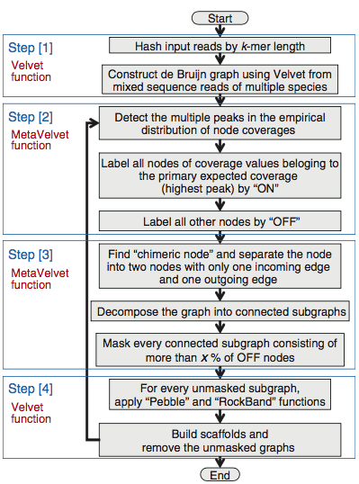
MetaValvet pipeline
Construct a de Bruijn graph from the input reads.
Detect peaks in the on the k-mer frequency distribution.
Decompose de Bruiin graph into sub-graphs.
Assemble contigs and scaffolds.

Slide 8
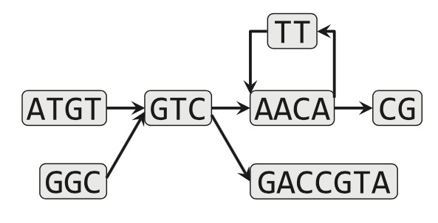
Step 1
MetaValvet uses Valvet functions to hash the mixed sequence reads of the multiple species by k-mer length. It then creates a de Bruijn graph of the hashed k-mers.

Slide 9
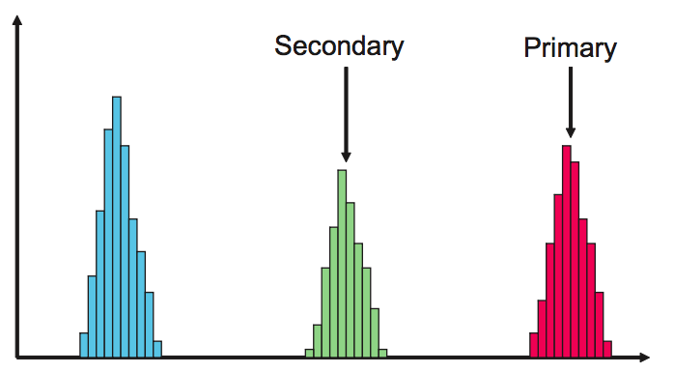
Step 2
MetaValvet calculates the histogram of the k-mer frequencies and finds the different peaks on the histogram. Each of the peaks on the histogram corresponds to the genome of one specie. MetaValvet then approximates the empirical distributions by a mixture of Poisson distributions and assigns each node in the de Bruijn graph to one of the Poisson distribution.

Slide 10
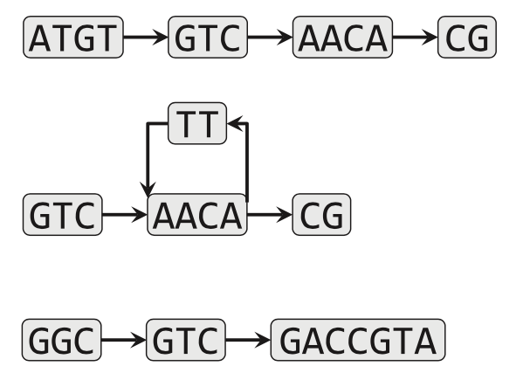
Step 3 & 4
MetaValvet distinguishes subgraphs belonging to the same peak and separates them from the other subgraphs.
MetaValvet then uses the Valvet functions to construct contigs and scaffolds from the decomposed graphs.

Slide 11
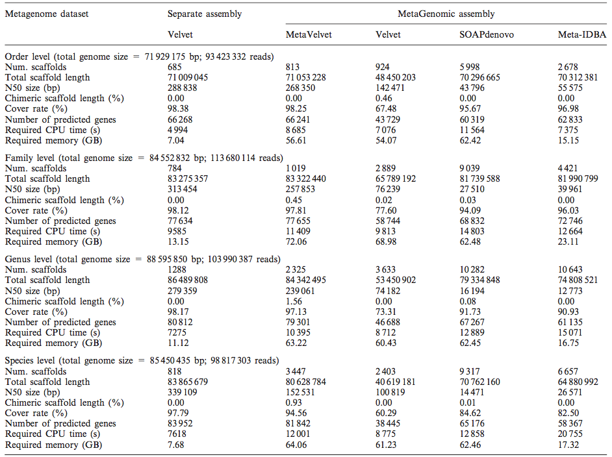
Results – Experimental Datasets
MetaValvet was able to beat the single-genome assembler, Valvet, as well as the metagenome assemblers, SOAPdenovo and Meta-IDBA, in almost all the categories. However, it does seem to require more memory than the other assembly algorithms.

Slide 12
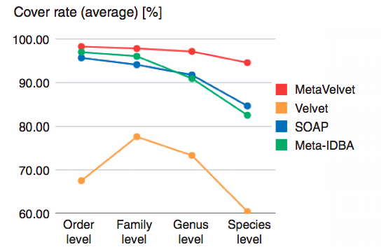
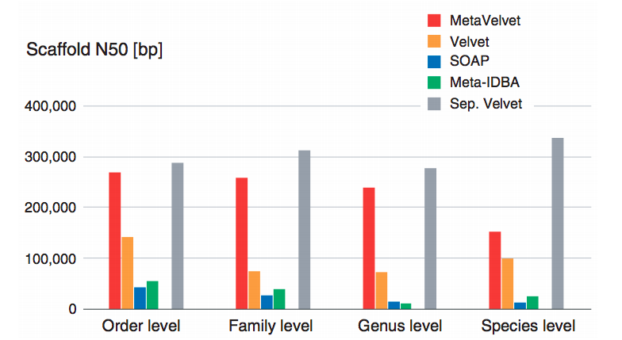
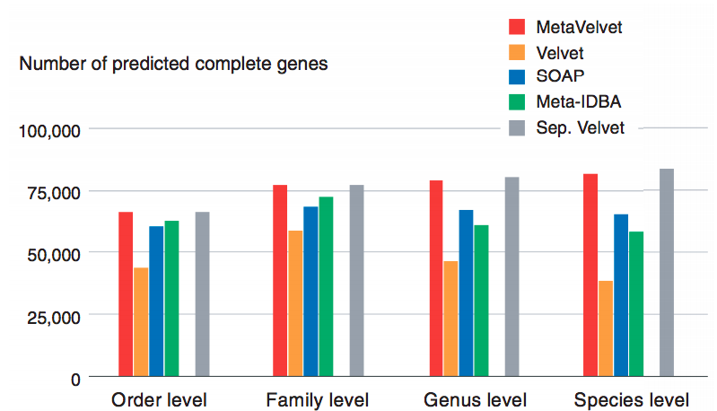
Results – Experimental Datasets (con’d)

Slide 13
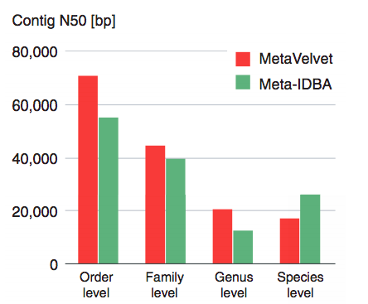
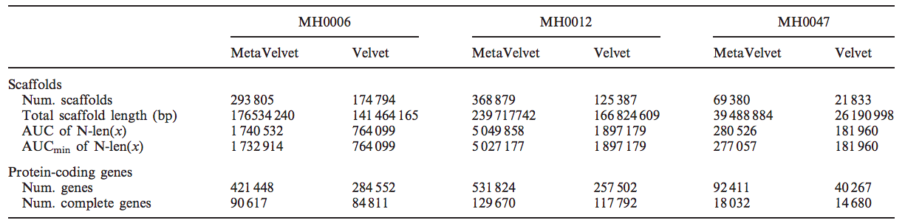
Results – Real Datasets
MetaValvet was also run on real datasets as a part of the project MetaHIT. The results shown on the side are from running MetaValvet on three different datasets of human gut microbial data. MetaValvet was able to output better numbers when compared to Valvet numbers.

Slide 14
Genome assembly for sequencing data with highly uneven depth
With IDBA-UD

Slide 15
The problem
Single-genome and metagenome assemblers assume that datasets have even depths, which results in the failure to construct correct long contigs.
This is caused by:
Incorrect k-mers.
Gaps.
Increased number of branches.

Slide 16
IDBA-UD
IDBA-UD adopts the idea of variable thresholds of Valvet-SC and enhances it to become a variable relative threshold, where the threshold is relative to the sequencing depths of the neighboring contigs, to tackle the incorrect k-mers problem. For the gaps and the increased number of branches problems, IDBA-UD adopts the k-mer range idea from IDBA to solve these problems.

Slide 17
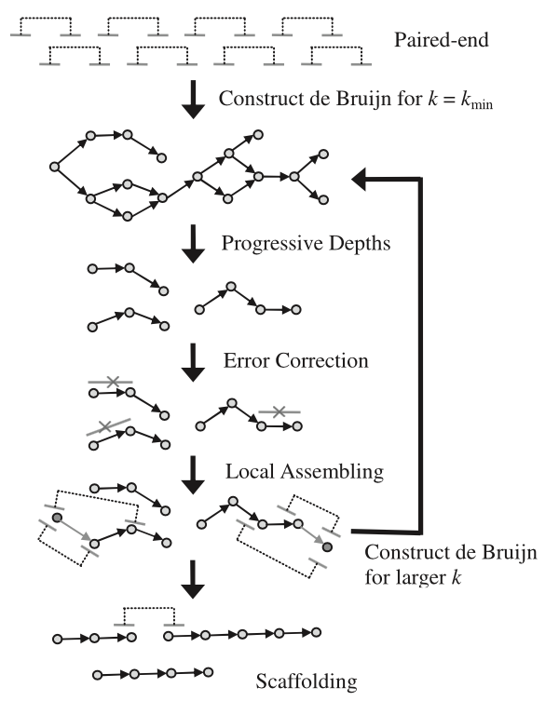
IDBA-UD pipeline
Construct de Bruijn graph
Progressive Depths
Error correction
Local Assembling
Feed a de Bruijn graph the results and increase the k value
Construct contigs and scaffolds

Slide 18
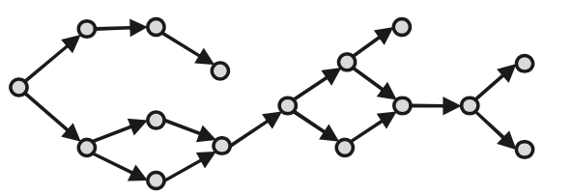
Step 1
Construct a de Bruijn graph from the sequence reads if on the first iteration. Else, construct a de Bruijn graph from the contigs generated from the previous iteration and increase the k value for the k-mer.

Slide 19
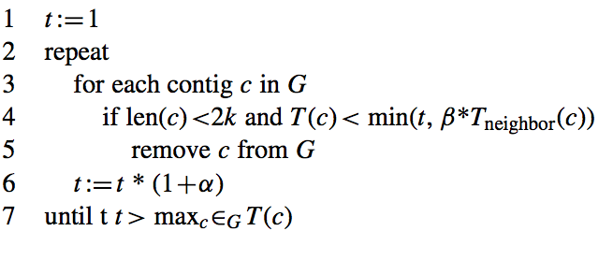
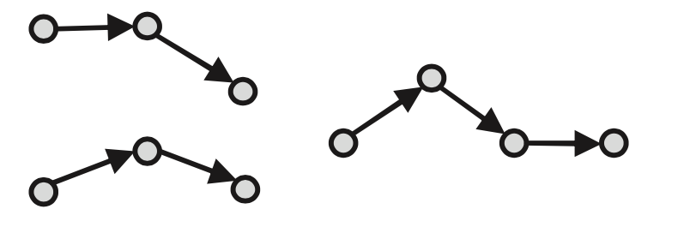
Step 2
Progressive relative depth is a function employed by IDBA-UD to filter the number of contigs generated from every iteration. The algorithm filters contigs based on their length, and their depth relative to the their neighboring contigs.

Slide 20
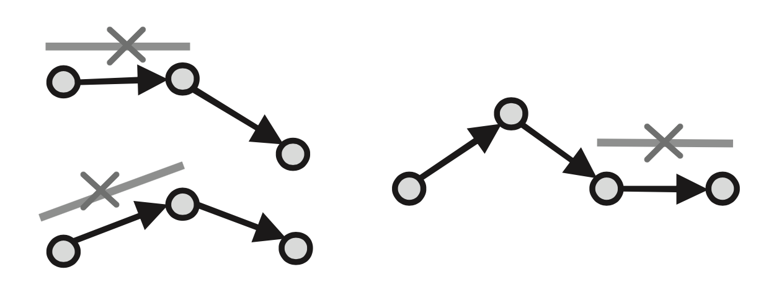
Step 3
Error correction is applied to newly structured contigs based on alignment between reads and confident contigs.

Slide 21
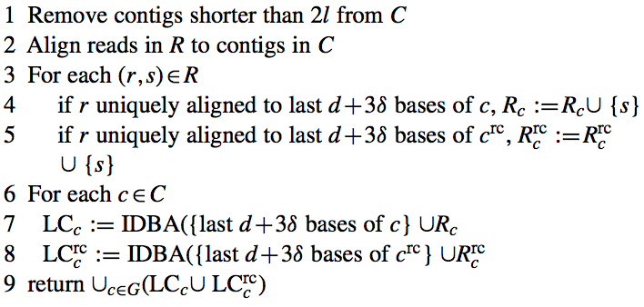
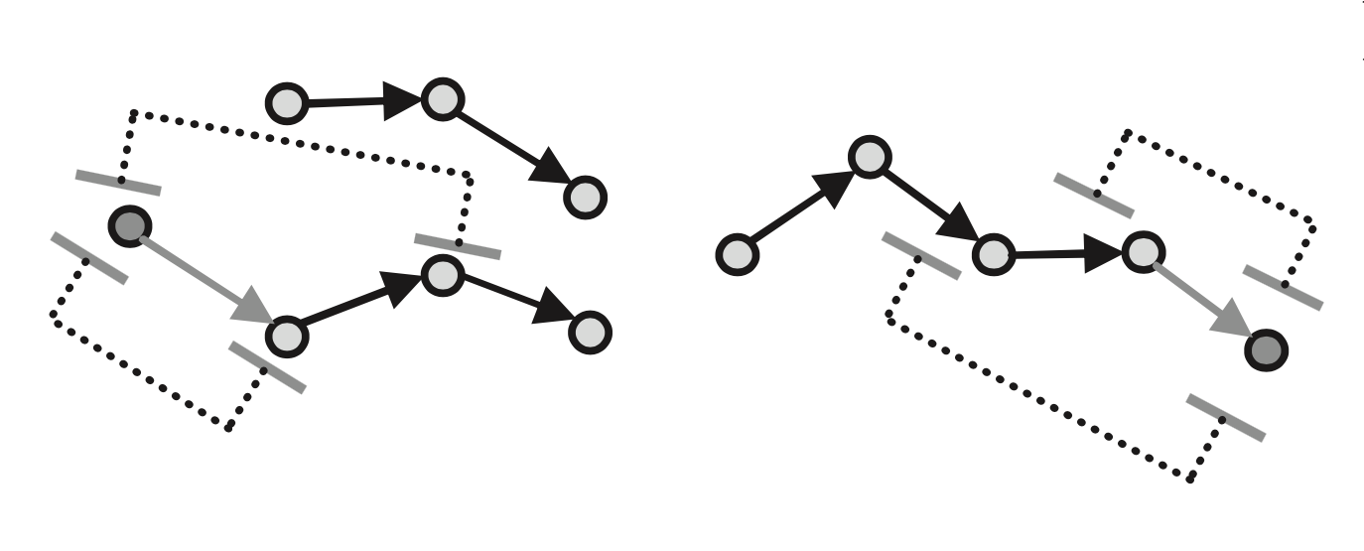
Step 4
Local assembly is used to construct missing k-mers to the gaps in the contigs.
Those missing k-mers cant be constructed even if they do not appear in any of the reads.
However, not all gaps can be filled by local assembly because of the ambiguity caused by branches.
Notes:
AACT, ACTG, 3-mer

Slide 22
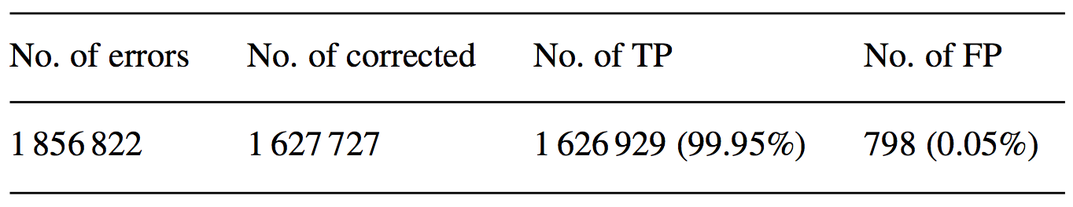
Results
Error Correction When run against reads sampled from Lactobacillus delbrueckii genome with 1 856 822 errors. IDBA-UD was able to correct 1 627 727 errors 99.95% of which were true positive.

Slide 23
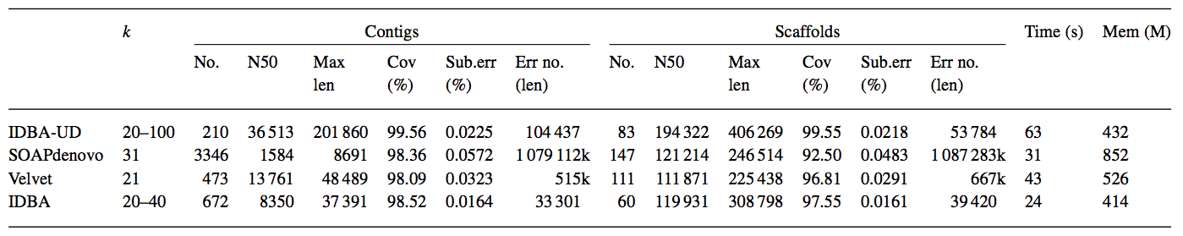
Results
Low depth assembly
The genome Lactobacillus plantarum was used to simulate low-depth dataset

Slide 24
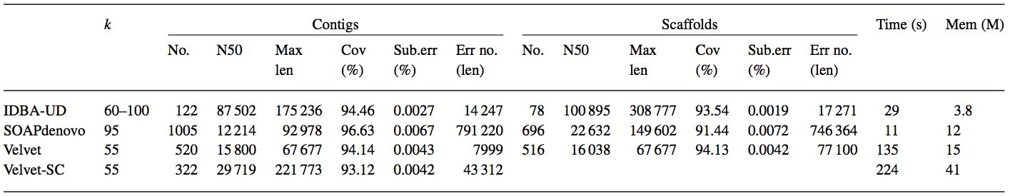
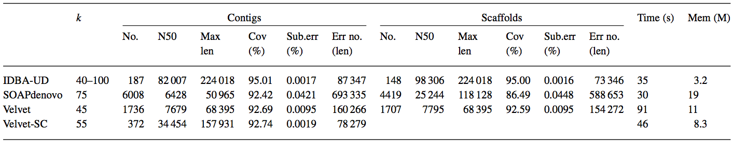
Results
Single cell assembly The results of the Escherichia coli genome are shown in the first table.
The results of the Staphylococcus aureus genome are shown in the second table

Slide 25
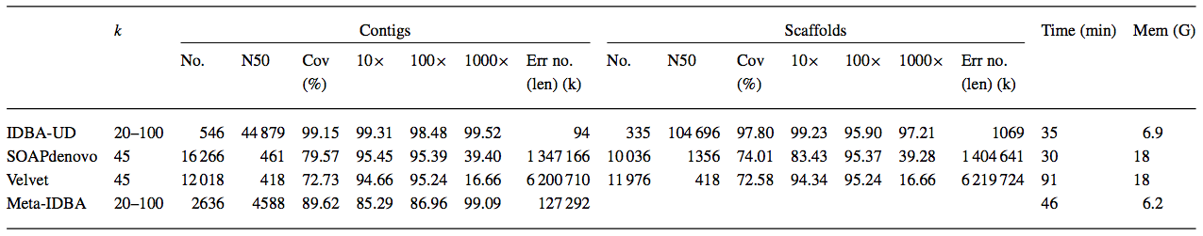
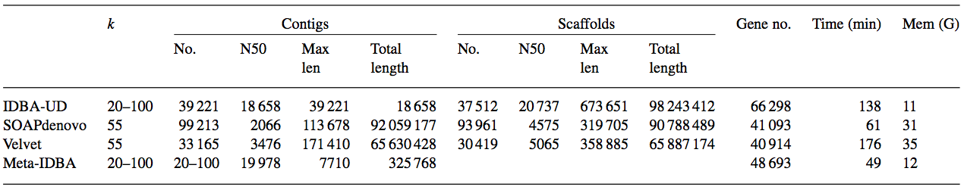
Results
Metagenomic assembly The results of the L.plantarum, L.delbrueckii, and L.reuteri F275 Kitasato genomes are shown in the first table.
The results of a human gut microbial metagenome are shown in the second table

